Slide 1
Whitaker Chalk Swindle & Schwartz PLLC
Originated in 1978
32 Attorneys, including 5 “Of Counsel”
27 staff, of which 4 are paralegals
Commercial Litigation
Fiduciary Litigation
Intellectual Property (trademarks, copyrights, patents)
Arbitration / Mediation
Real Estate, Oil & Gas, Corporate, Non-Profit Orgs.
Employment Law, Non-Competes
Wills, Probate, Trusts, Asset Protection
Mission Statement: To aggressively pursue and obtain the best results for our clients consistent with their stated goals.

Slide 2
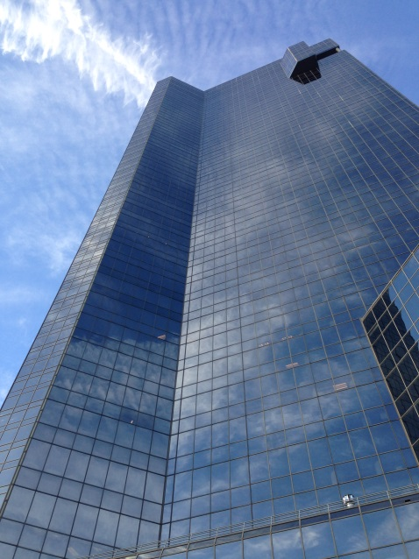
Thomas S. Brandon, Jr.
Whitaker Chalk Swindle & Schwartz PLLC
301 Commerce St, Suite 3500
Fort Worth, TX 76102
817-878-0500 (main)
817-878-0532 (direct dial)
tbrandon@whitakerchalk.com
www.whitakerchalk.com

Slide 3
Protecting Your Trade Secrets
Because you don’t know what you don’t know and that can hurt you (or your company)!

Slide 4
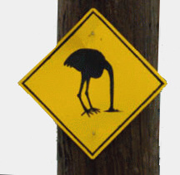
Worst thing you can do!

Slide 5
I. Trade Secrets, what are they?
A. Introduction.
Texas has adopted the Texas Uniform Trade Secrets Act (TUTSA). Its purpose is to define trade secrets and provide guidelines and remedies to businesses whose trade secrets are exposed.

Slide 6
Definition of Trade Secret
Under Section 134A.002(6) of the Texas Uniform Trade Secrets Act (TUTSA), a trade secret is information that has been protected by reasonable measures. The information is valuable because it adds a benefit to the product or service.
Trade secrets can be the ingredients in a recipe, a manufacturing process, or any other information that provides an advantage or key element to a business. TUTSA states that Texas trade secrets include any business, scientific, technical, economic, or engineering information, as well as any design, prototype, plan, program device, code, or procedure related to a business.

Slide 7
What a trade secret is not:
Any item that can be reversed engineered is probably not a trade secret. (You might have a patent, tradename or copyright, but it will not be a trade secret). Example: making a “widget.”

Slide 8
II. Importance of Trade Secrets
If a trade secret is crucial to the success of your business, it is important to protect that secret!
For example, if you make chocolate cookies and your cookies are better than everyone else's it could be because of the recipe which includes a special ingredient. It could be because of the ratio of that ingredient to other ingredients. It could be your baking process.
All of those things set your cookies apart, and without that "secret" your cookies would be like everyone else's. So as a successful entrepreneur, you wouldn't want your cookie secret leaked to your competitors. This is where the TUTSA applies.
Coca Cola trade secret?

Slide 9
III. Steps to Protect your Trade Secrets
1. Identify the trade secret and label materials that contain protectable trade secrets.
2. Ask employees, customers, independent contractors, and vendors with access to confidential information to sign a confidentiality or non-disclosure agreement.
3. Limit access to information on a need-to-know basis. Carefully vet and perform background checks on all people who have access to trade secrets and continue to monitor the personality, behavior, and work habits of all employees who have access to trade secrets.

Slide 10
4. Promulgate policies to encourage information security. This includes NDAs, policy manuals, intended use policies, computer login screens, and non-compete agreements.
5. Train employees on how to handle trade secrets and specifically address the handling and confidentiality of trade secrets in the employee handbook.

Slide 11
6. Provide physical security and cyber security. Store information securely and monitor where the confidential information is stored. Ensure the physical security of buildings and areas where confidential activities are happening. Secure computers and networks via industry-leading standards including encryption, strong passwords, or biometric locks. Maintain control over passwords and restrictions.
7. Conduct exit (closing) interviews to remind employees of their legal obligations to protect trade secrets. Make sure departing employees return information and company-owner devices and delete sensitive information from personal devices. DON’T FORGET THE STORAGE ON THE CLOUD OR OTHER OFF-SITE STORAGE. Upon or before termination, immediately end the employee’s access to emails and accounts.

Slide 12
8. Have an incident response plan that outlines the steps to be taken in the event of an intrusion or theft of a trade secret. Make sure it includes steps to identify the information that has been stolen, determine how much of the network needs to be shut down, quarantined, or isolated, secure or archive all relevant activity, document who discovered the theft or intrusion, and determine when the theft occurred and if its ongoing.

Slide 13
IV. Further Considerations on Maintaining Secrecy
1. Consider how remote work affects trade secret protection
To protect information disseminated over Zoom, Teams, or other remote meeting and sharing venues, companies need to: (1) have employees acknowledge the information’s confidentiality; (2) keep track of attendees; and, (3) have a method to prevent the unauthorized access to the calls or misuse of documents which have trade secret protection shared.
Updated confidentiality policies should establish guidelines on videoconferencing.
2. Avoid or limit disclosure of protectable secrets to people in other
countries (not every country has the same trade secret protections).
3. Employers must consistently enforce their policies!

Slide 14
V. What’s Next after Protecting your Trade Secrets?
A company must be diligent in administering its policies and being aware of and identifying threats to its Trade Secrets.
1. Know who might be a threat to the misappropriation of your Trade Secrets.
a. Thief (usually an online thief);
b. Competitor;
c. Employee or Contractor; or
d. Adversary.

Slide 15
2. Personal Insider threat indicators:
Disgruntled
Poor performance ratings
Exhibits “above the rules” attitude
Routinely goes to executives and by-passes supervisor
Undisclosed foreign travel or excessive or unusual foreign travel
Unjustified work pattern (nights, weekends, or remote work)
Numerous security infractions
Excessive use of copier, scanner, or faxes
Chronic expression of being under-recognized at work
Unexplained affluence

Slide 16
3. Technology insider threat indicators:
Increased non-business related activities on the internet (web surfing, job hunting, social media)
Increased foreign IP traffic
Increased email and USB storage/transfers to employee’s private email or third-party email with attachments
Repeated responder to phishing attacks
Purging or wiping system before termination
Posting sensitive information on social media
Speaks out against company leadership or company on social media
Conducting unexplained network or company database searches
Attempting remote access after being laid off or terminated
Encrypting emails to private or personal accounts

Slide 17
VI. So, what Happens if your Trade Secrets are Misappropriated?
The legal cause of action for exposed information is called the "misappropriation of trade secrets.“
Misappropriation occurs when a trade secret is improperly acquired, or the trade secret is disclosed or used without consent. Consent to use the secret may be expressed or implied. There are several factors that a court will likely take into consideration when evaluating a claim of misappropriation.

Slide 18
Some of these factors may include:
- The scope of the trade secret known outside of the business;
- The degree of knowledge possessed by others involved in the
business, including employees;
- The measures taken by the business to keep the information a secret;
- The value of the information to the success of the business;
- The value of the information to competitors of the business;
- Time, money, and effort put into developing the trade secret; and
- How easy or difficult it may be for competitors to acquire or duplicate the protected information.
A misappropriated trade secret does not actually have to be used in order for you to seek legal remedies!

Slide 19
VII. Legal Remedies for Trade Secret Misappropriation under the TUTSA
Injunctive Relief
Injunctive relief is available if actual or threatened misappropriation takes place. Injunctive relief prevents the potential or continued use of trade secret information. In exceptional circumstances, an injunction may allow royalties to be paid as a condition for future use.
Damages
The value of the trade secret and how much it impacts the business determines economic damage. This may include actual loss caused by the use of the information and unjust enrichment. Compensation for royalties from the use of the information may be appropriate in limited situations. Further, if the defendant's behavior was malicious, the court may choose to award punitive damages to punish the behavior.

Slide 20
Attorney Fees
If it hadn't been for the misappropriation, you would not have had the unexpected cost of attorney fees. The court has the ability (meaning “can” but not “required”) to award attorney fees to the prevailing party.

Slide 21
VIII. Conclusion
MAINTAINING SECRECY UNDER TUTSA
The Texas Uniform Trade Secrets Act (TUTSA) states that the information cannot just be deemed a secret by the owner after it has been exposed. The company must show that they took reasonable efforts to protect the trade secret.
Efforts made to prevent disclosure of the trade secret are required by the court to help the court determine the importance placed on the information before it was exposed.
If it is a trade secret that is important to you make sure you implement steps to protect it.

